Slide 1
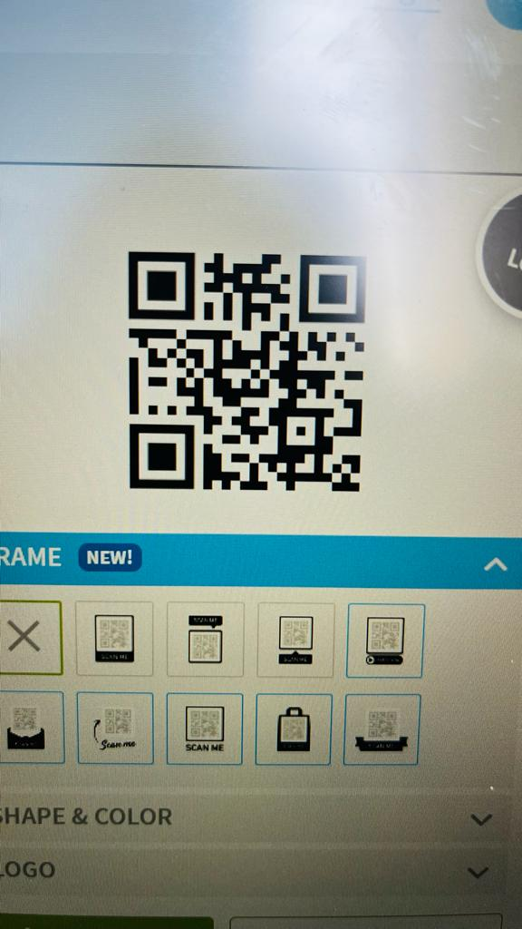

Slide 2

















Phishy
Team:31

Slide 3













What is
QUISHING
Phishing via QR (Quick Response) codes.
WHY
&
for whom

Slide 4
TEAM MEMBERS AND THEIR ROLES
Architha G V B A
(QR conversion , flask for chrome extension)
Samhitha B Naidu
(QR conversion , chrome extension)
Pallavi Harish
( MultinomialNB model for ML TRAINING)
Janani A.M
(INITIALIZE DATA TO TOKENIZATION)
Mohini v
(finding data set)
K Joshna Naidu
( LINEAR REGRESSION model for ML TRAINING)

Slide 5

PROBLEM STATEMENT
QR Phishing :
These days we find QR codes everywhere and they are used for transaction purpose as well as finding content in just a click.
Your paragraph text

Slide 6








How does it work?
Scan the QR code
QR code to URL conversion
Ml model gets the URL input
4.
Determines whether the QR code is likely to be malicious or not

Slide 7





Tools Used
ML
Front End
Integration tool
Others
Training on
COLLAB
JavaScript
CSS
HTML
Pycharm
Canva
Vs code
Figma

Slide 8
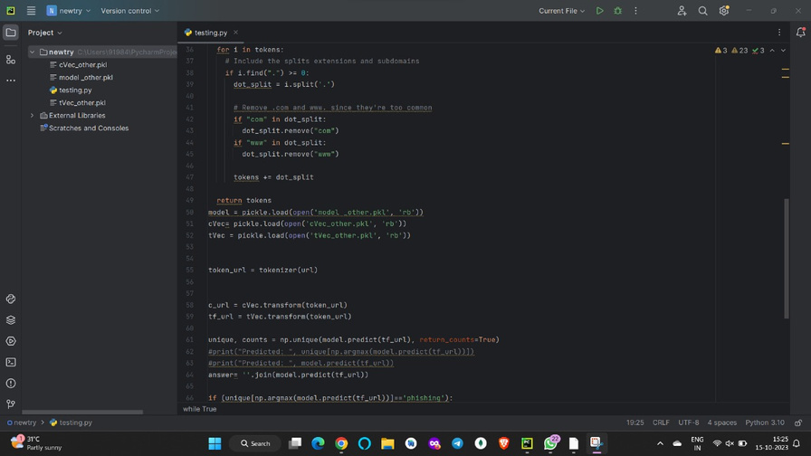

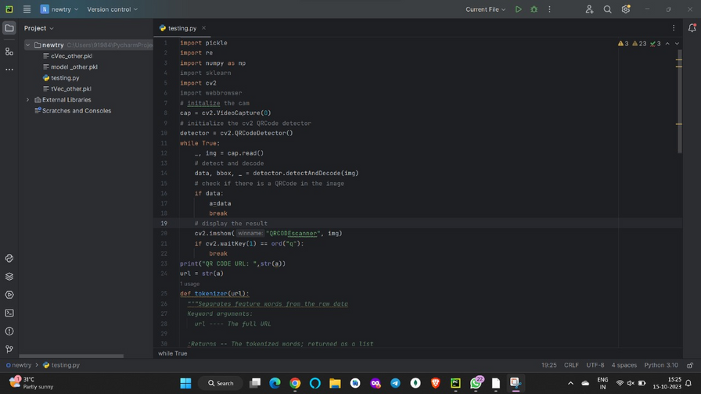

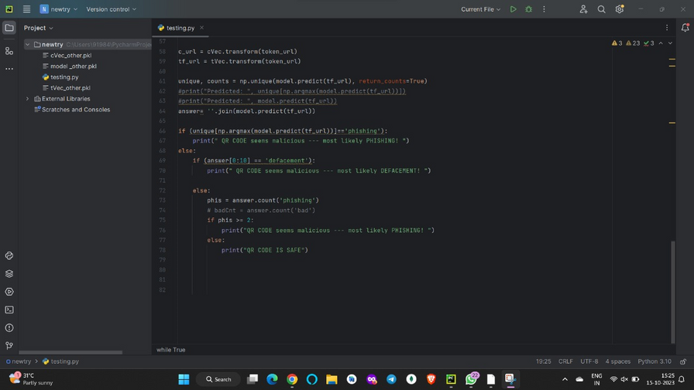
Source Code:

Slide 9



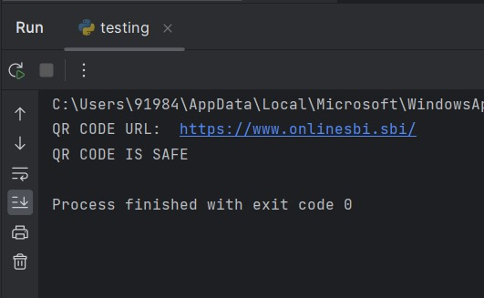
OUTPUT

Slide 10
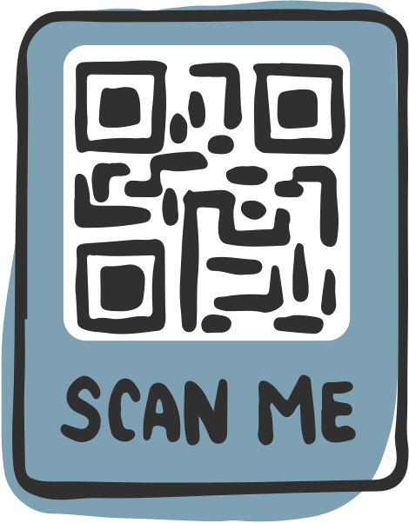


Slide 11
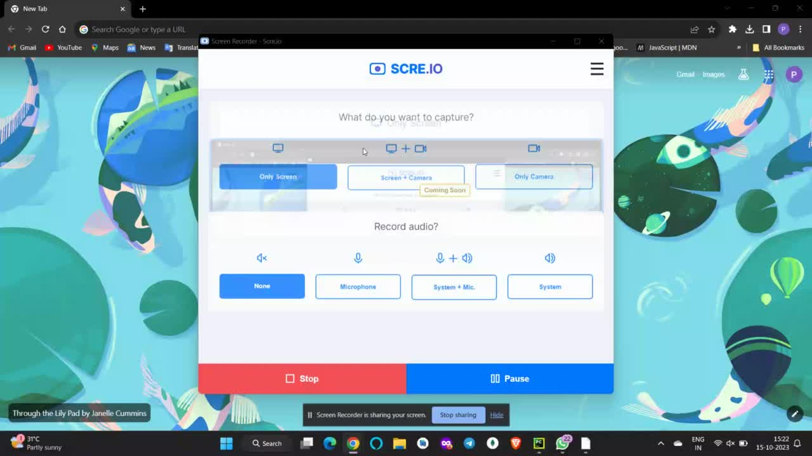

Slide 12

WOW FACTORS
Machine learning
Use of advanced kaggle dataset
Efficient real time prospects
Exponential growth in accuracy with more training and time

Slide 13
LEARNINGS DURING HACKATHON
Front end programming
Machine learning
flask
python libraries
open cv

Slide 14


Protection to qr code scanner
Future
Prospects
Integrating with UPI scanner
Everyday scanning application
URL extensions

Slide 15
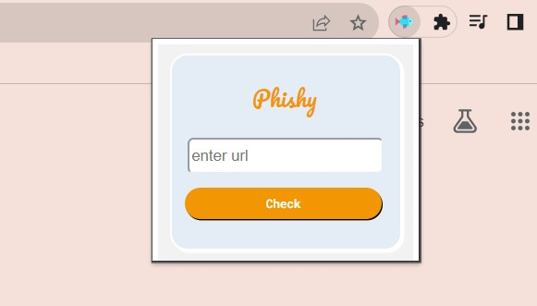
Future
Prospects

Slide 16
















Thank You!

